Slide 1
Best Place to Live Seattle vs San Francisco
Capstone Project Presntation
Author: Juan Vargas
March 05 2020

Slide 2
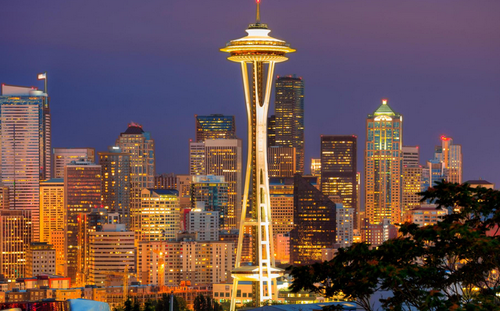
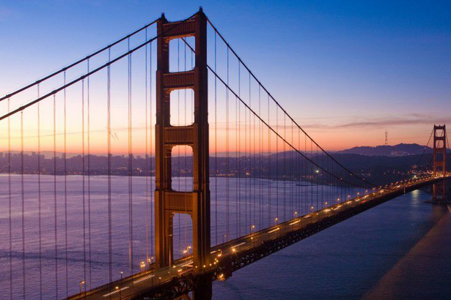
Introduction
Background of the problem
Data
Data required
Methodology
Steps and processes to solve the problem
Results
Presentation of the results
Conclusion
• How the analysis will help to take a better decision

Slide 3
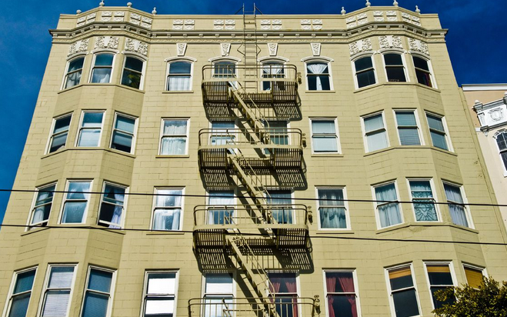
Introduction
It does not really matter where you come from if you have the skills and make the commitment there is a 'back breaking' job waiting for you there, tech jobs pay handsomely but rent prices specially in the bay area (San Francisco) are not cheap.

Slide 4
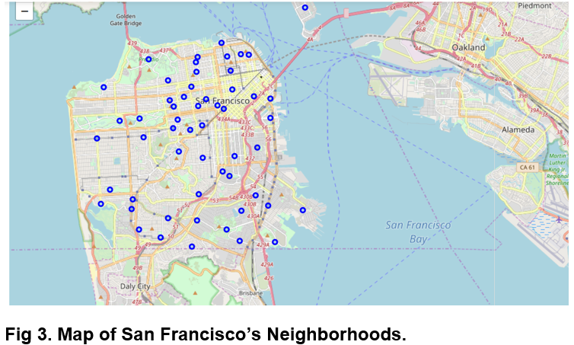
Data
The visuals will let the investor (reader) see on a map the relative closeness to a future working address
Map of San Francisco’s Neighborhoods.

Slide 5
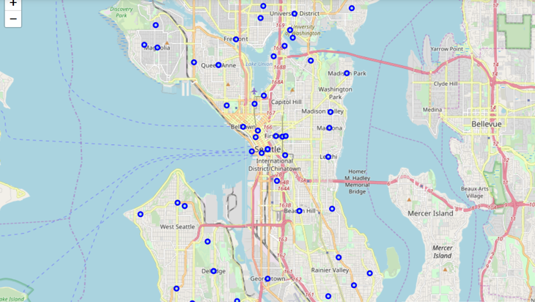
Utilizing geopy along the proper coordinates of the cities I'll create the data frames need it for making visual maps of the neighborhoods.
Map of Seattle’s Neighborhoods

Slide 6
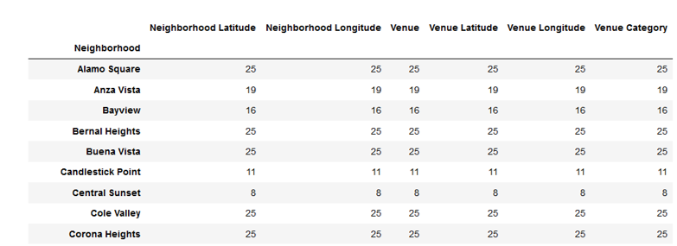
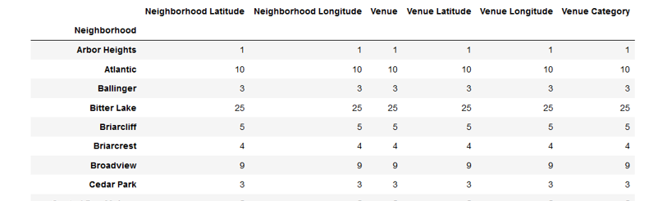
Collecting the Data
Data scraping from websites cited on the references at the end of this report was collected and converted into data frames with help of the library pandas using the programming language python, additionally coordinates information was acquired with the help of Nominatim and geocode, at first I tried geocoder with no success so I decided to switch libraries, simultaneously the coordinates information was added to the data frames for each city.
Data Frame of San Francisco venues in each
neighborhood.
Data Frame of Seattle venues in each neighborhood.

Slide 7




Methodology
TOOLS:
Sklearn
Kmeans
FourSquare
Kmeans
Matplotlib
Seaborne
Data has been collected scraping websites with the necessary information, some data cleaning has been performed and some reshaping still remains to be performed in order to compare rent prices in both cities, statistical methods will be employed in order to achieve this purpose, the tools used so far are the following:
Pandas
Numpy
Geopy
Nominatim
Geocode
Folium

Slide 8
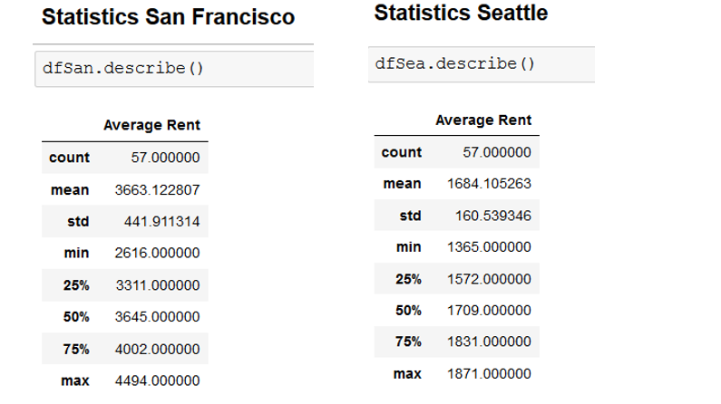
Results
The research and analysis applied for this project returned the following information regarding the tech cities compared.
Statistical comparison between San Francisco and Seattle.

Slide 9
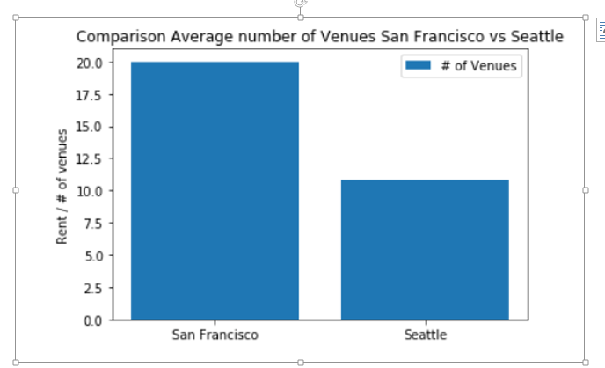
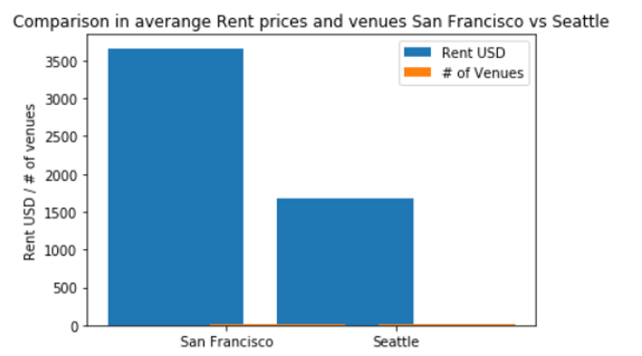
The results are pretty clear living in any of those two cities and in the USA in general is not cheap, the minimum average rent for Seattle is $1375 USD and $2616 USD for San Francisco, and let’s considers that this keeps going up.
Comparison of number of venues in
San Francisco and in Seattle
Comparison Rent in USD and number of venues in San Francisco and in Seattle

Slide 10
Conclusion
If it is in your plans work in the USA in any of the major tech cities like San Francisco or Seattle you should really consider not only the salary that you will earn there, but also the cost of living should be a really big factor in your decision, and lets not even mention the hours and fast pace style of living that you might not be used to.
Also I think that is important to mention that rent prices keep going up in those cities as they keep attracting the best brains in the world and the huge amount of money injected there from investors worldwide keeps real state and cost of living sky high.

Slide 11
references
[1] "https://www.businessinsider.com/san-francisco-housing-so-expensive-people-leaving-2018-4/?r=MX&IR=T"
[2] "https://matplotlib.org/"
[3] "https://www.rentcafe.com/average-rent-market-trends/us/ca/san-francisco/"
[4] "https://www.rentcafe.com/average-rent-market-trends/us/wa/seattle/"
[5] "https://towardsdatascience.com/geocode-with-python-161ec1e62b89"
THANK YOU!

